Slide 1
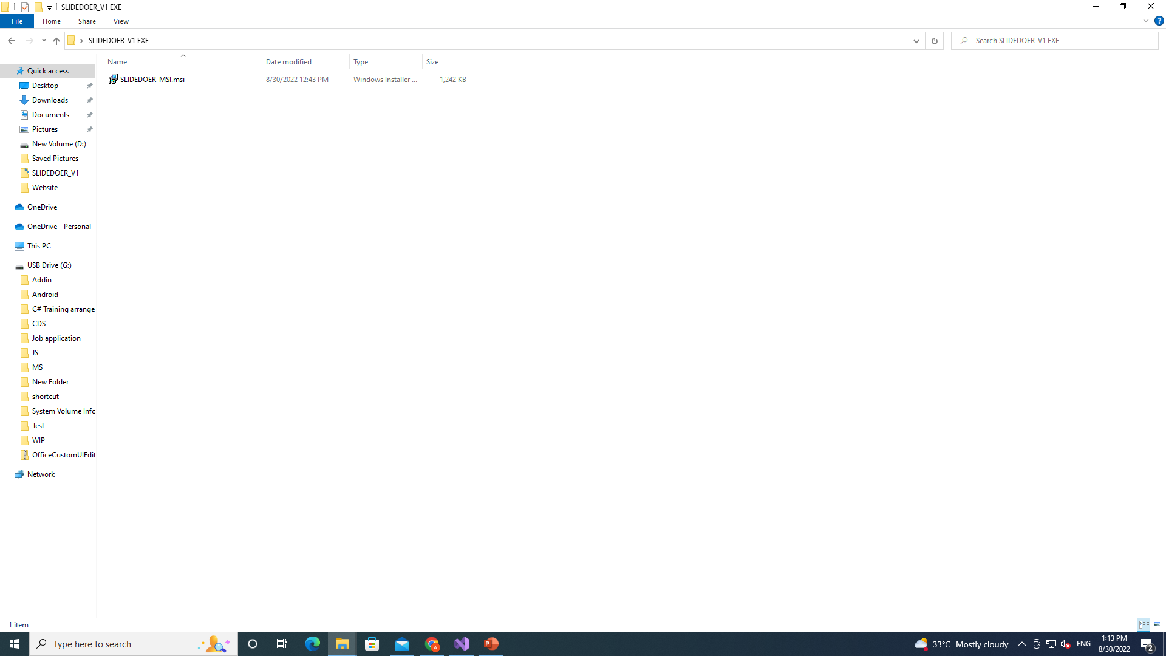
Run this file, it will create a shortcut in desktop with the name “SLIDEDOER_v1.exe” then double click the shortcut and reopen the powerpoint

Slide 2
How to solve ms vsto "certificate not trusted" issue

Slide 3
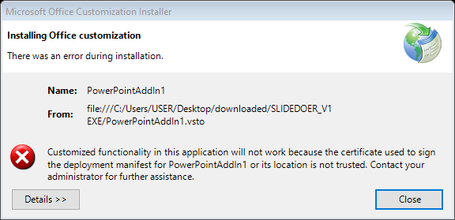

Slide 4
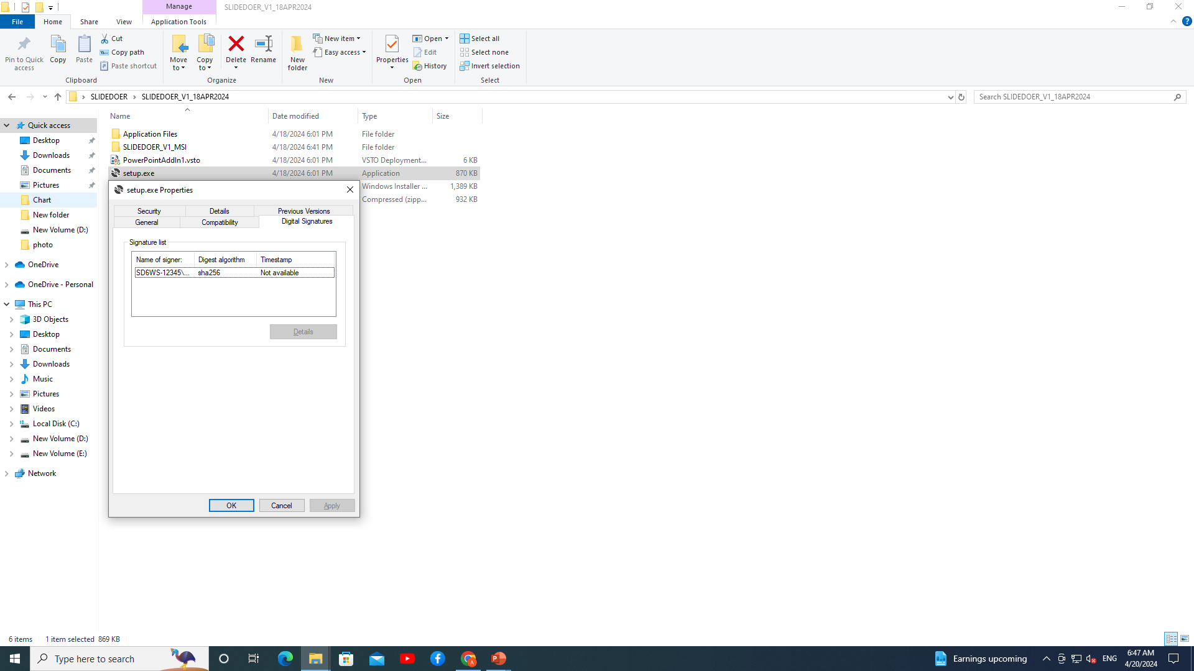

Slide 5
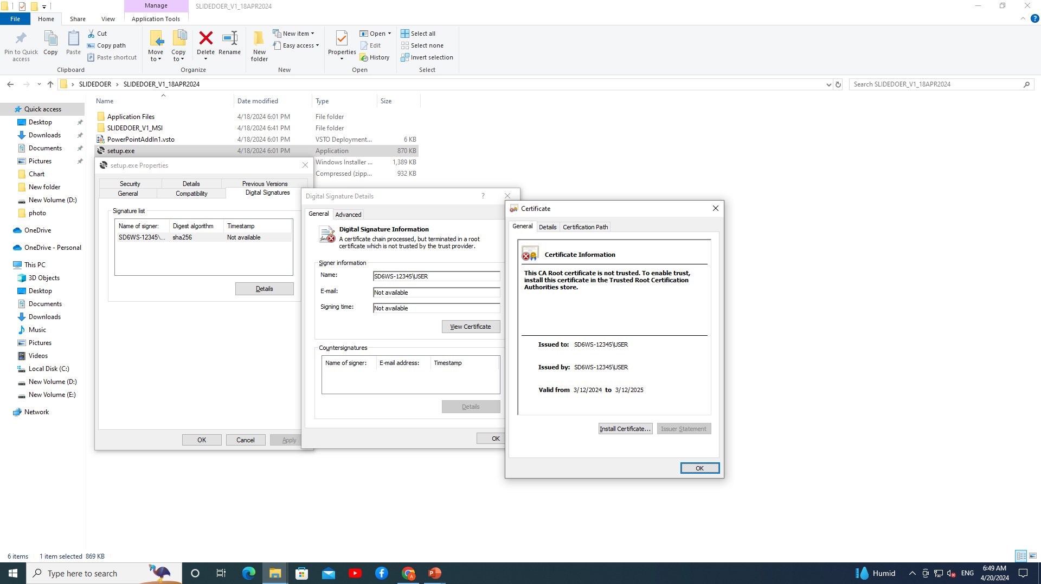

Slide 6
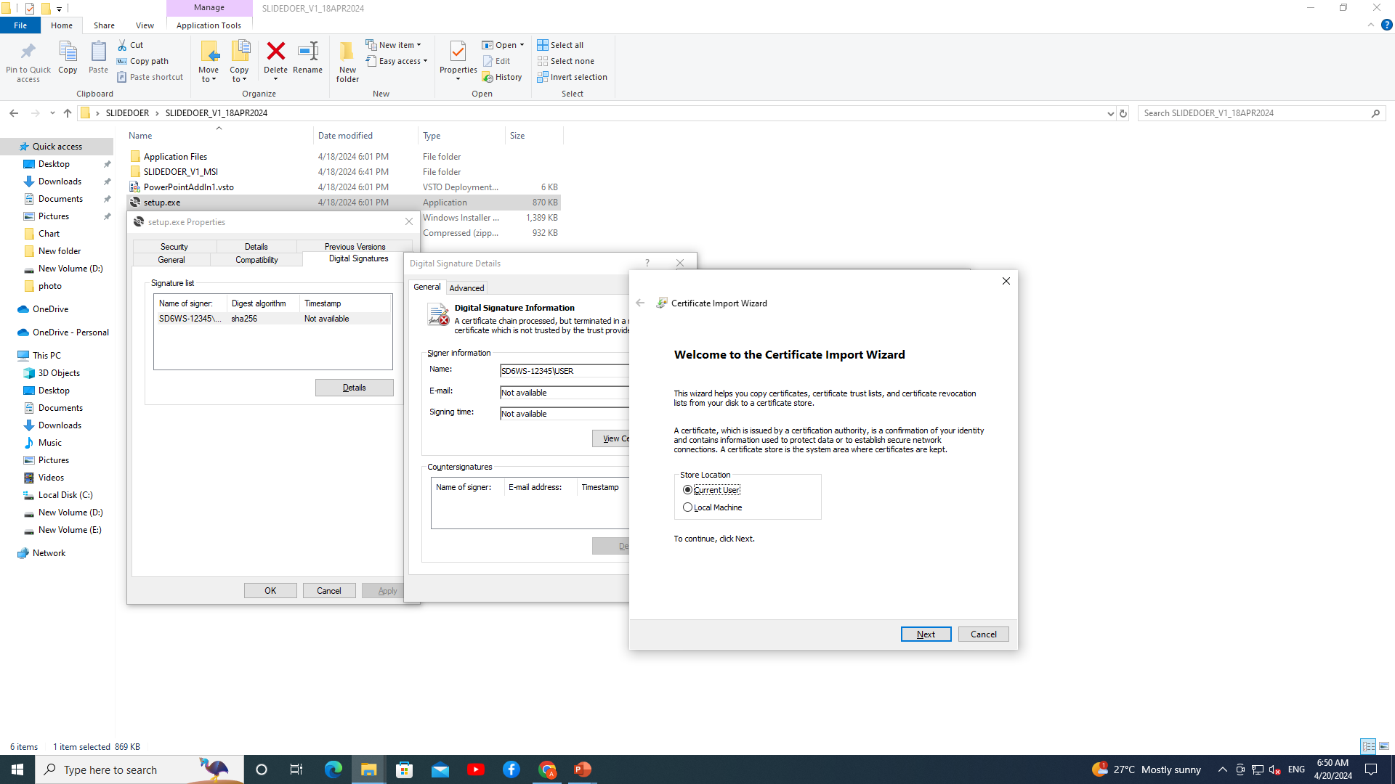

Slide 7
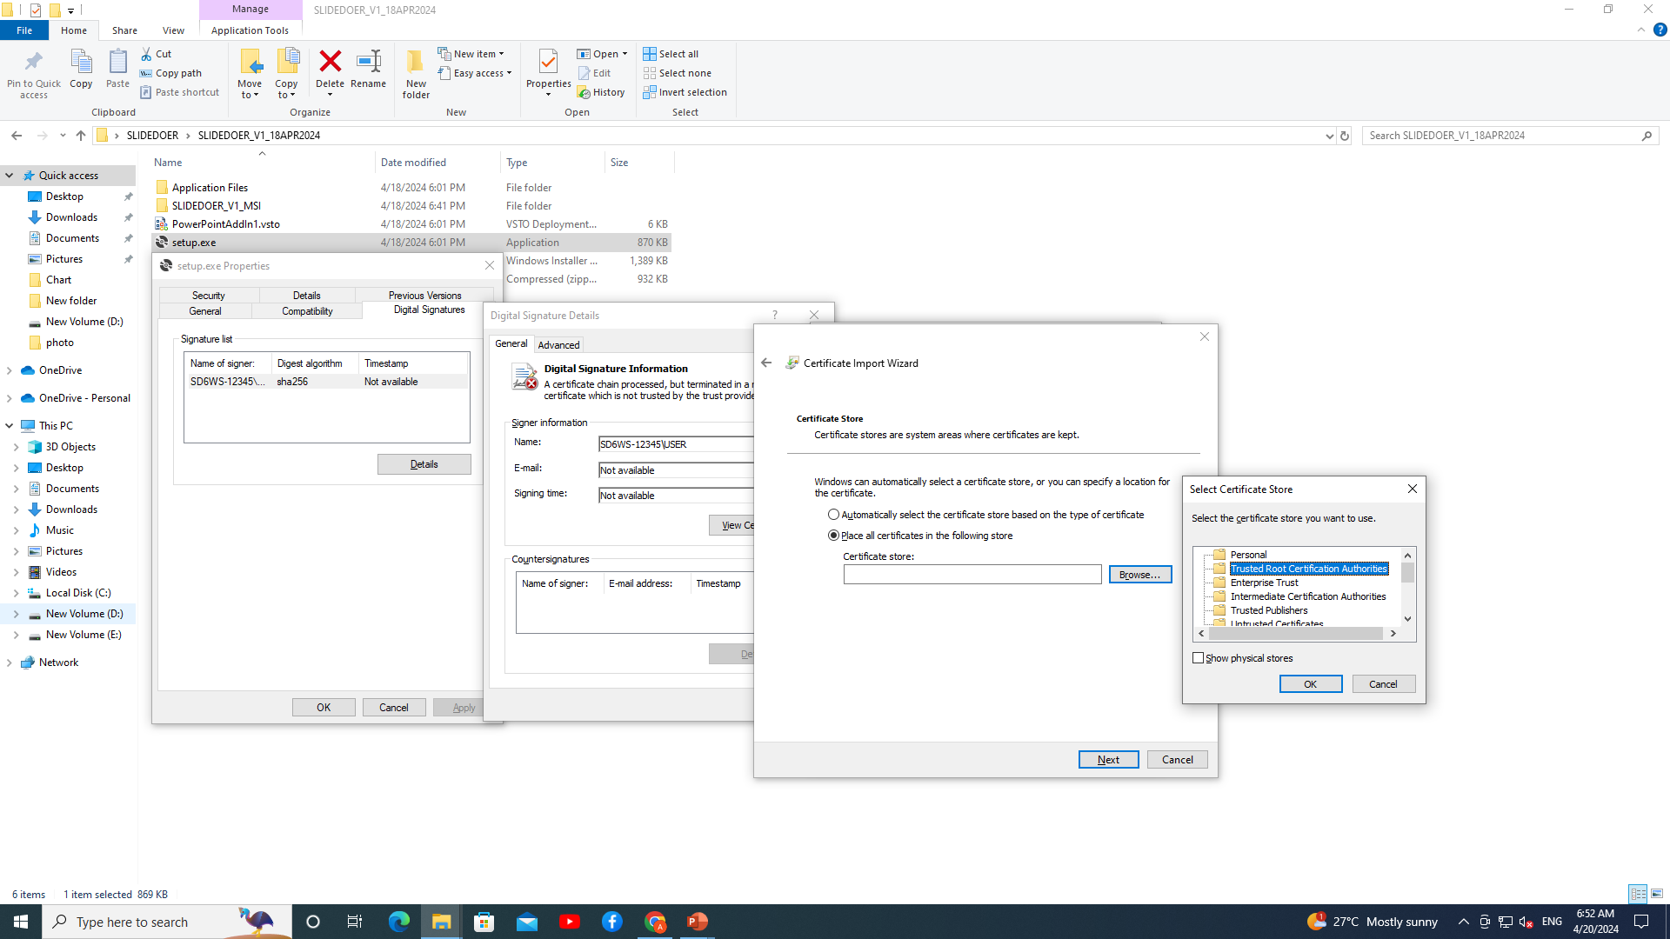

Slide 8
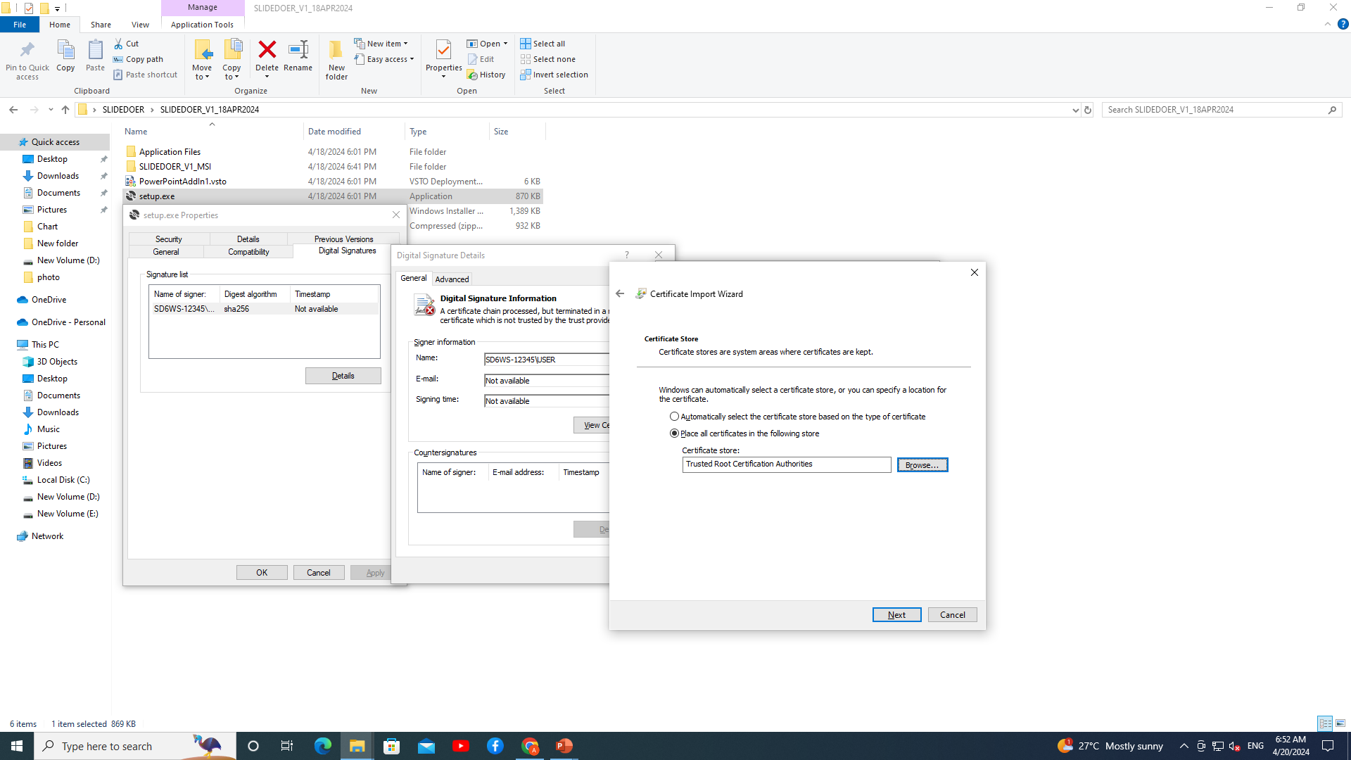

Slide 9
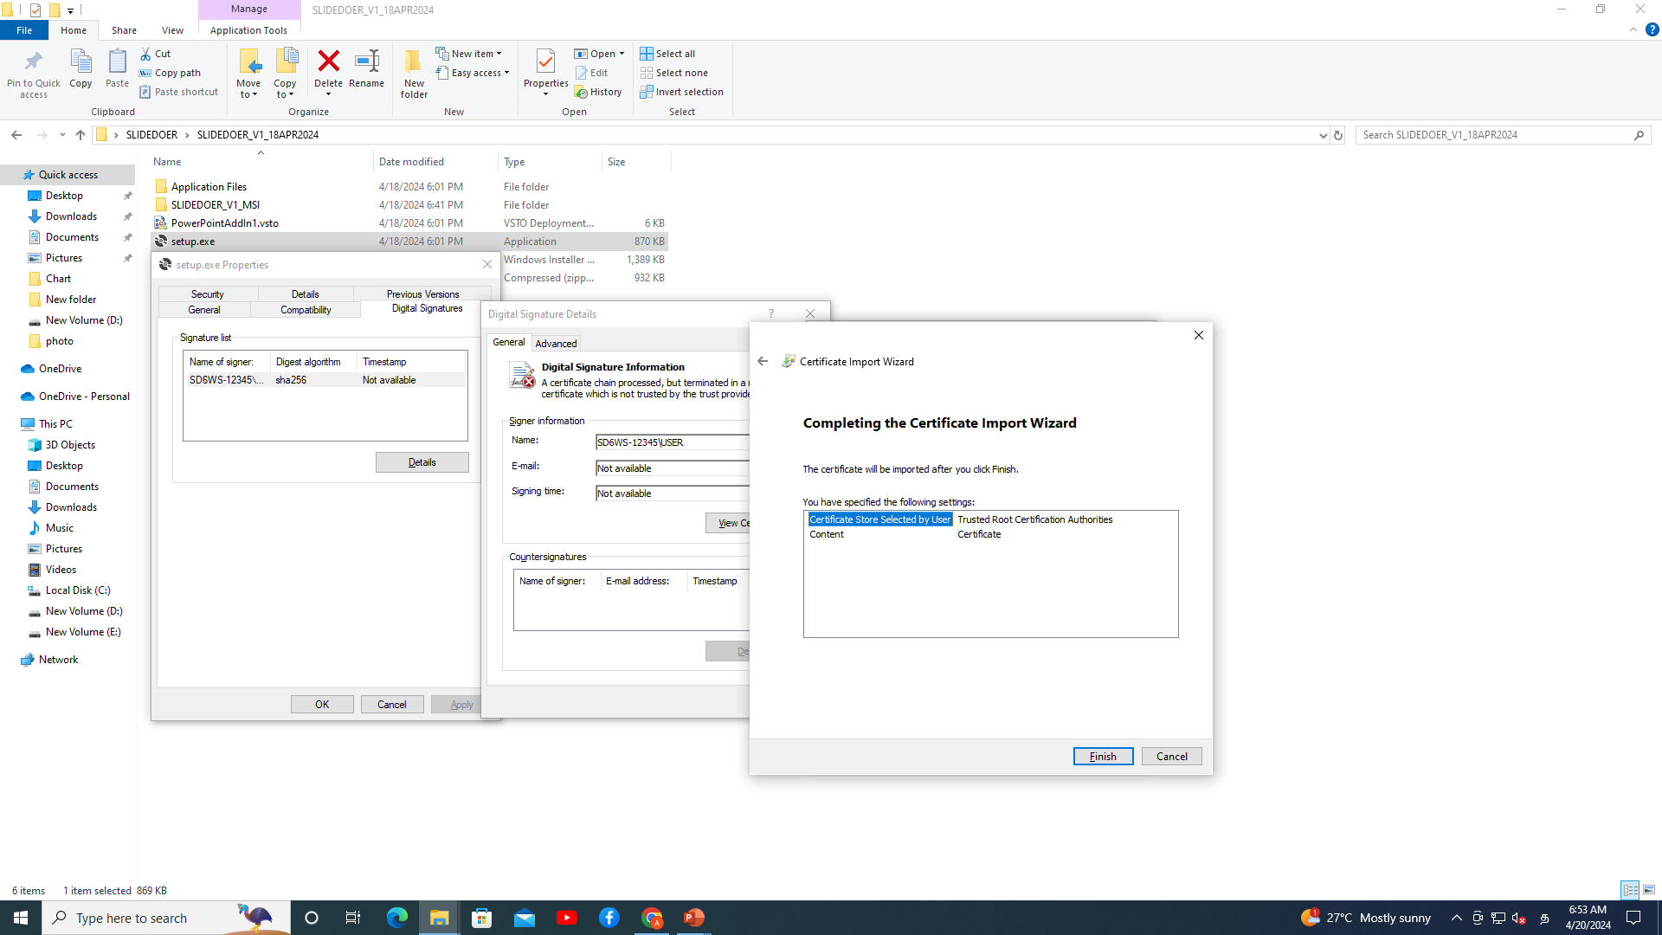

Slide 10
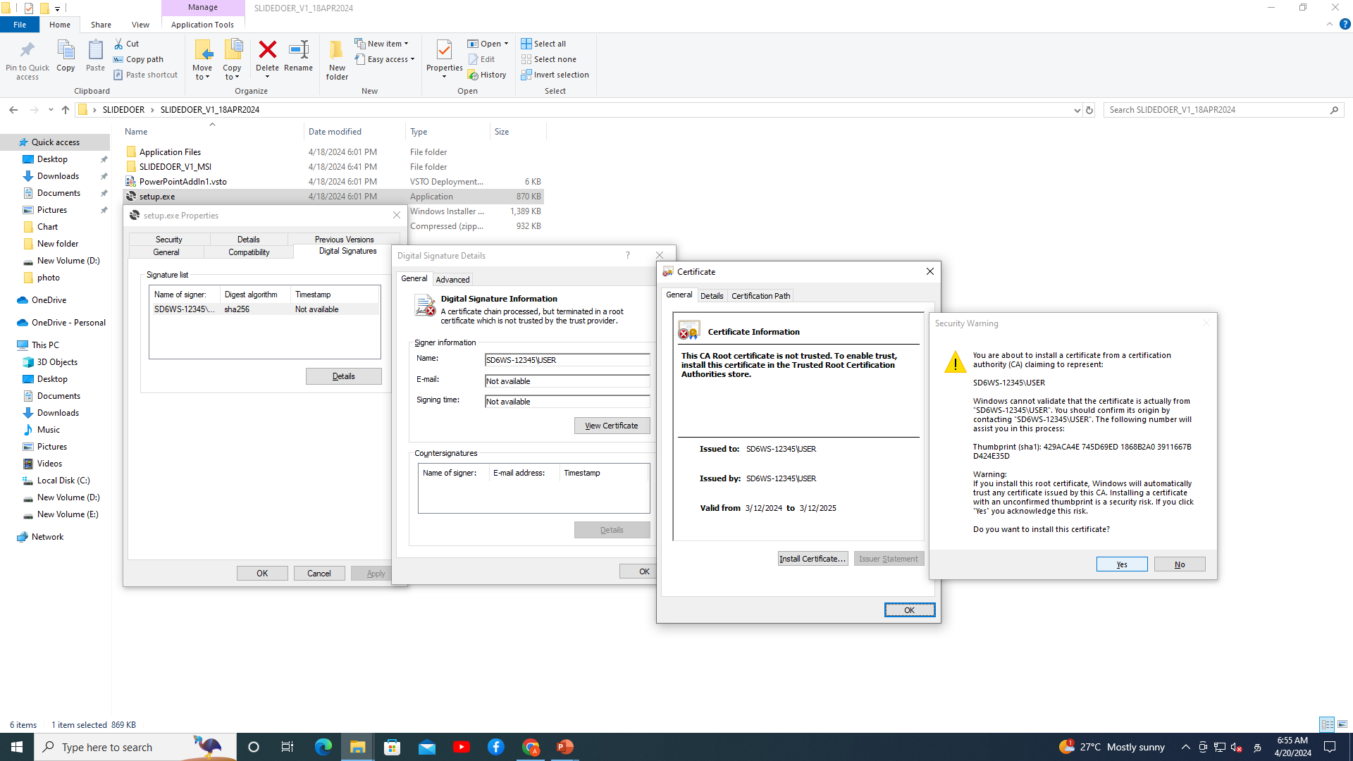

Slide 11
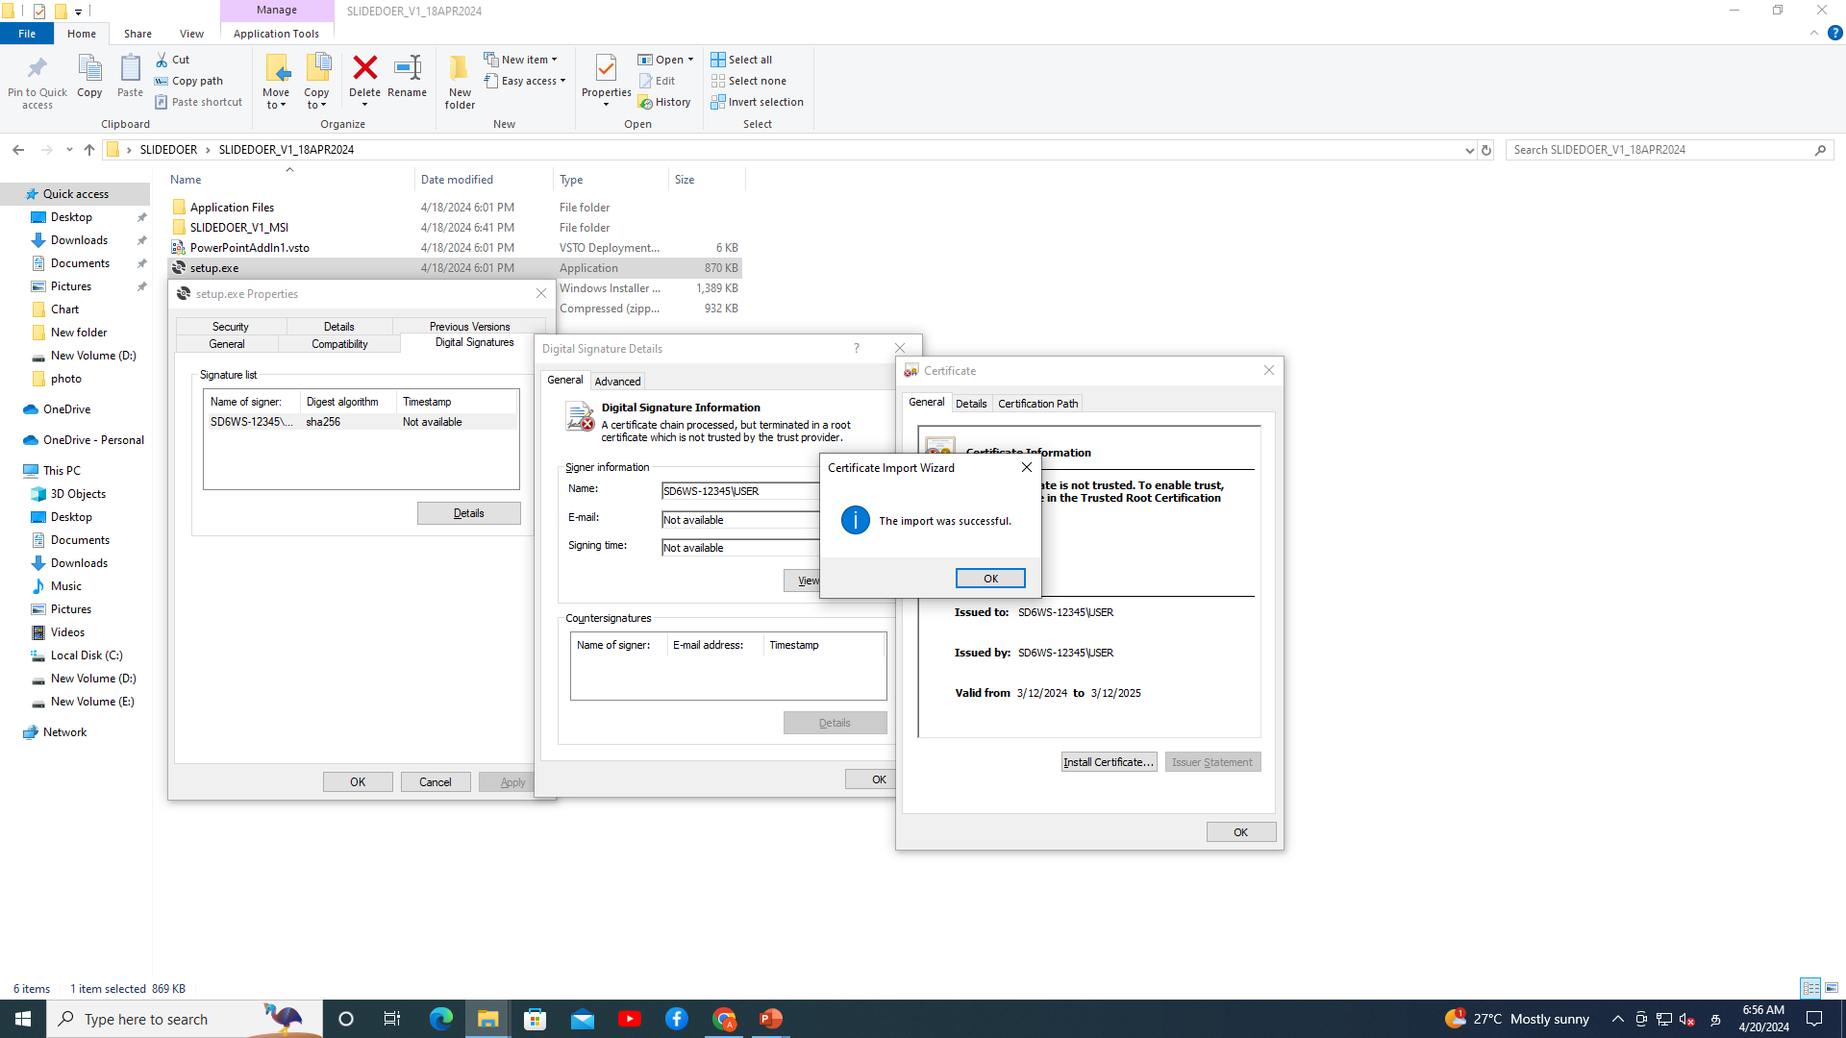

Slide 12
The solution cannot be installed because it is signed by a publisher whom you have not yet chosen to trust. If you trust the publisher, add the certificate to the Trusted Publisher list

Slide 13
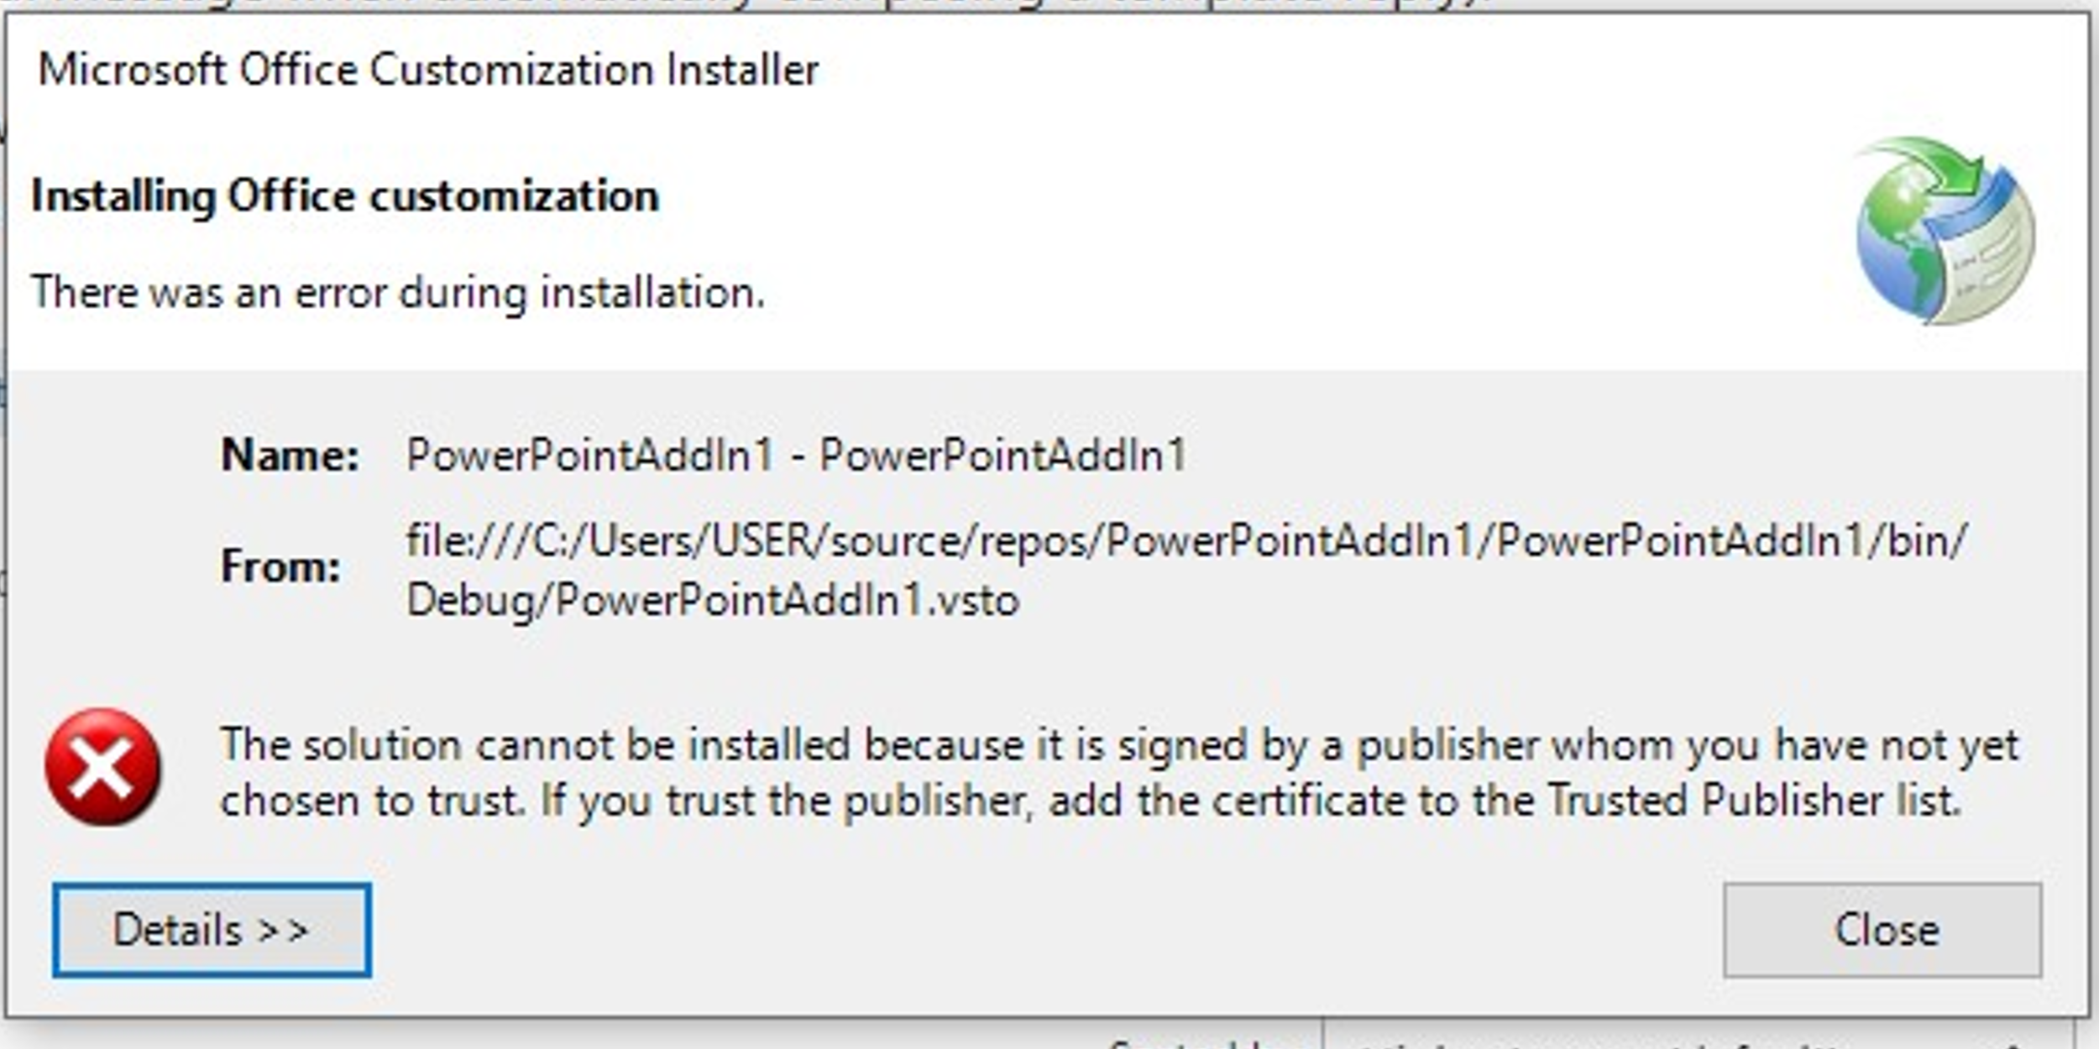
While installing SLIDEDOER program, if the below message appears, follow the instruction, given on slides 3,4 and 5

Slide 14
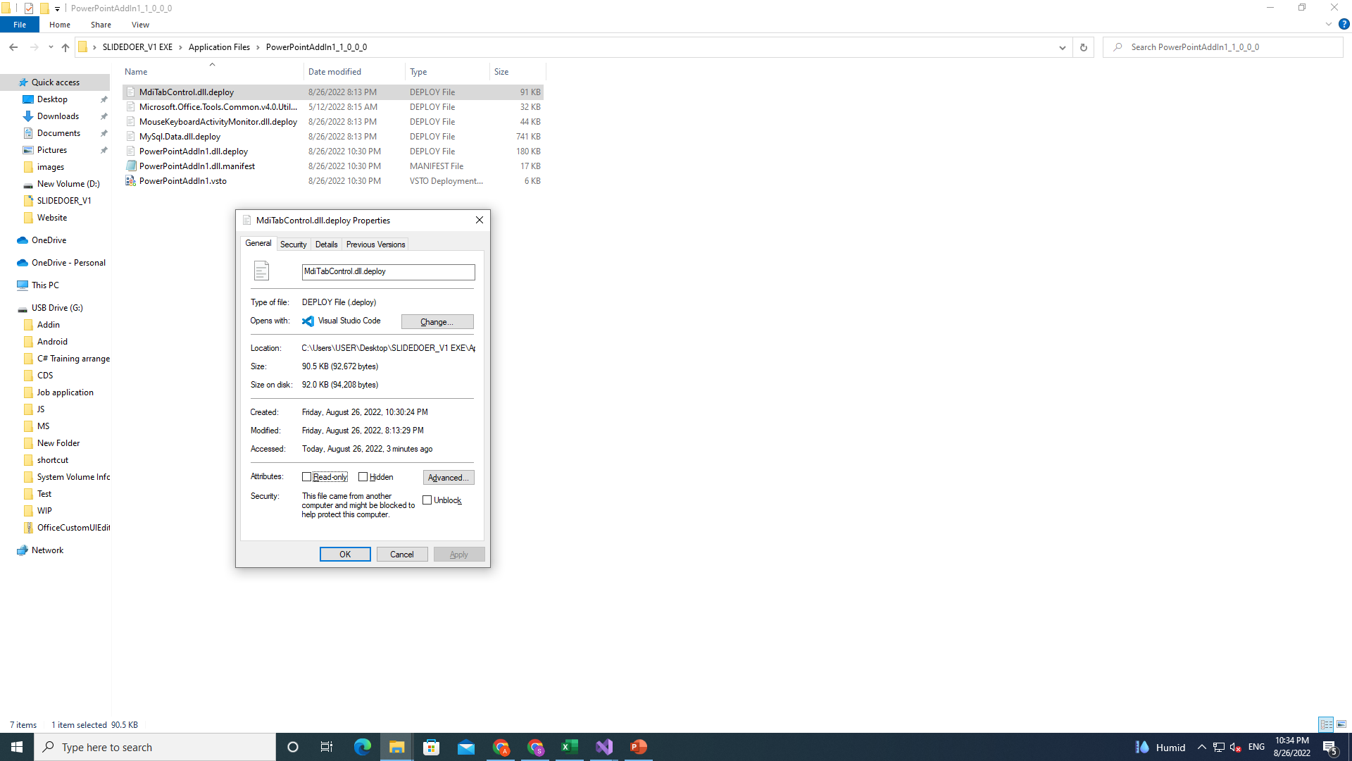
Right click all the files in SLIDEDOER_V1 EXE
if Unblock is checked, uncheck like this

Slide 15
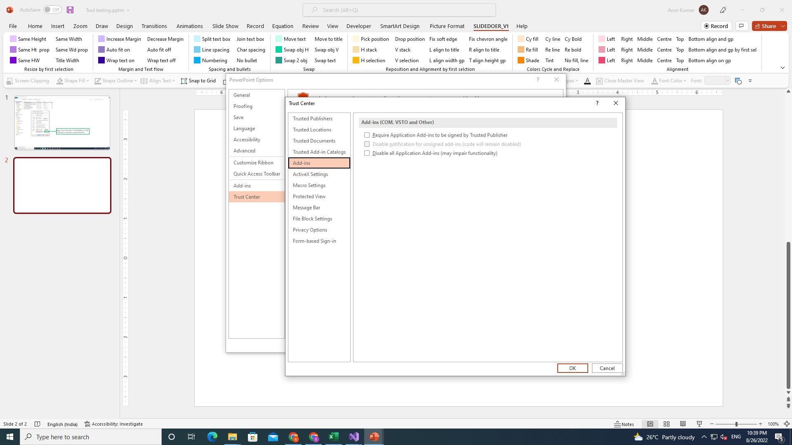
If checked, uncheck like this

Slide 16
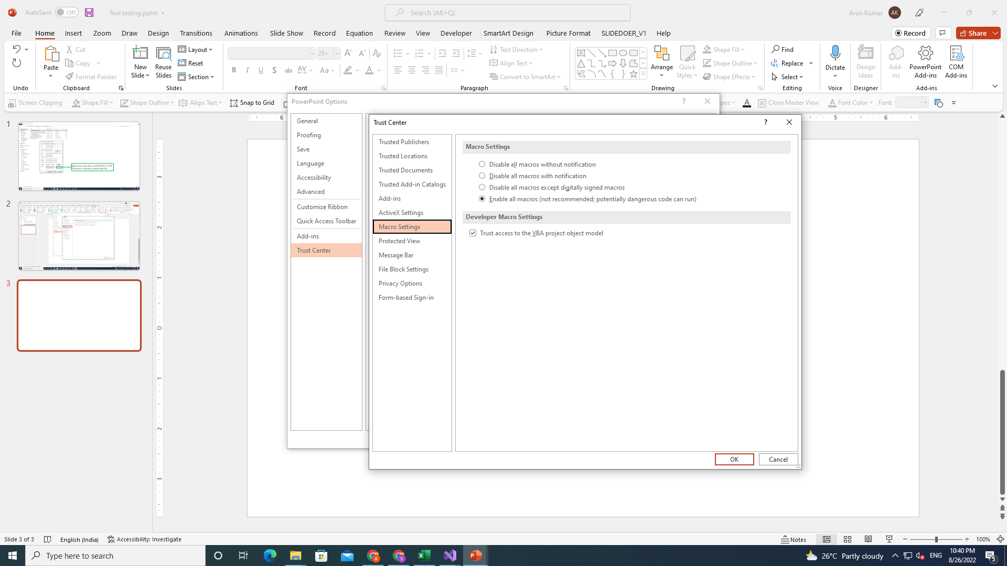
If not selected, select this

Slide 17
Activate admin login, If not visible,
while login windows

Slide 18
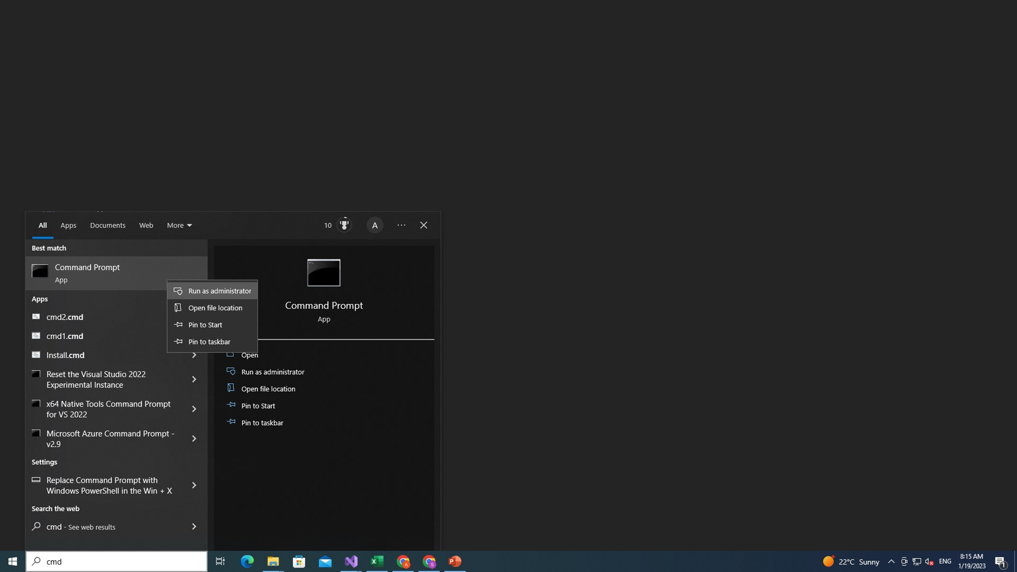

Slide 19
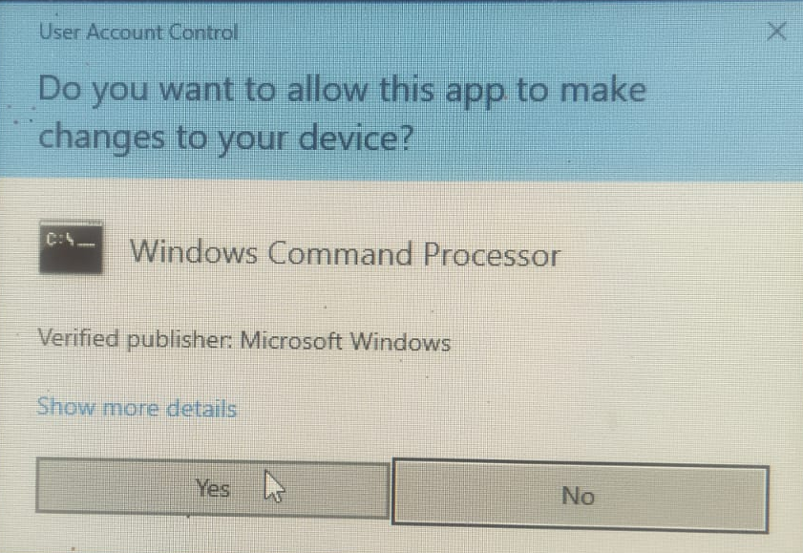

Slide 20
